Slide 1
Perioperative management for patients with anticoagulant (warfarin) or antiplatelet therapy

Slide 2
Introduction
-Perioperative management of patients on warfarin or antiplatelet therapy involves assessing and balancing individual risks for thromboembolism and bleeding.
- Discontinuing anticoagulant and antiplatelet therapis usually necessary for major surgery but increases the
risk of thrombotic events.
-Bridge therapy -ie, the temporary use of intravenous unfractionated heparin (IV UFH) or low-molecular-weight heparin (LMWH) prior to surgery in place of warfarin—, is an effective means of reducing the risk of thromboembolism but may increase the risk of bleeding.

Slide 3
-The timing of warfarin withdrawal and timing of the preoperative and postoperative components of bridge therapy are critical to balancing these risks.
-Perioperative management of antiplatelet therapy requires special care in patients with coronary stents; the timing of surgery relative to stent placement dictates management in these patients.
Premature discontinuation of antiplatelet therapy in--
surgical patients with recent coronary stent placement
significantly raises the risk of catastrophic perioperative
stent thrombosis.

Slide 4
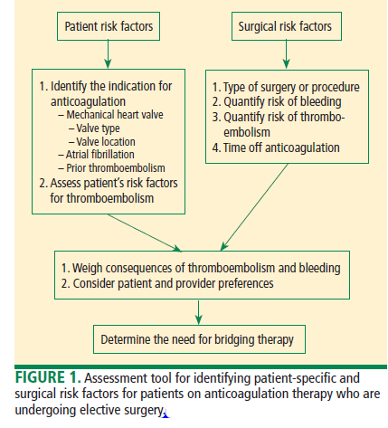

Slide 5
In 2008 the American College of Chest Physicians
(ACCP) published the latest update of its consensus
guidelines for the perioperative management of patients
receiving antithrombotic therapy.
The guidelines’ recommendations for anticoagulant management are based on stratification of patients into risk categories according to their underlying indication for longterm anticoagulation—ie, presence of a mechanical heart valve, history of atrial fibrillation, or history of venous thromboembolism (VTE).

Slide 6
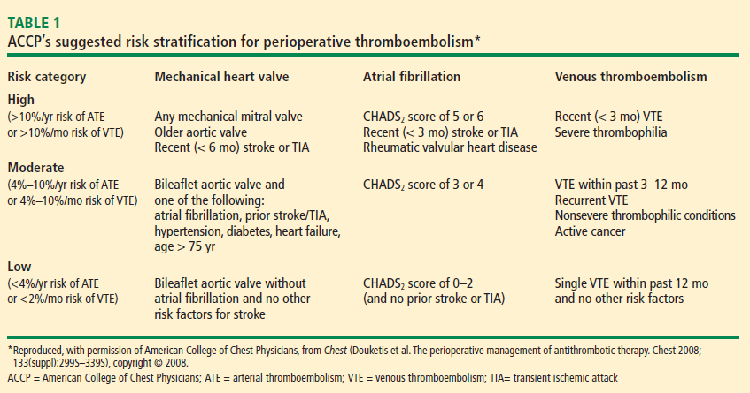

Slide 8
Bridging anticoagulation (bridge therapy) is central to the ACCP’s recommendations for perioperative management in patients on long-term anticoagulant therapy. Key ACCP recommendations for these patients, according to their risk for thromboembolism are as follows:
• High risk: bridging anticoagulation with therapeutic- dose subcutaneous LMWH or IV UFH
• Moderate risk: bridging anticoagulation with
therapeutic-dose subcutaneous LMWH, therapeutic dose
IV UFH, or low-dose subcutaneous LMWH
• Low risk: bridging anticoagulation with low dose
subcutaneous LMWH or no bridging.

Slide 9
A PRACTICAL APPROACH TO BRIDGE THERAPY
A bridge therapy protocol for patients receiving warfarin has been successfully used at the Cleveland Clinic,
Warfarin should be discontinued far enough in advance of surgery to achieve a preoperative target INR of less than 1.2. Age is associated with a slower rate of decrease in the INR, and there is wide interpatient variation. The INR should always be checked prior to surgery.

Slide 10
Before surgery :
• Discontinue warfarin 5 days before surgery (ie, hold four doses) if the preoperative international normalized ratio (INR) is 2 to 3, and 6 days before surgery (hold five doses) if the INR is 3 to 4.5.
• For bridge therapy, start LMWH (enoxaparin 1 mg/kg or dalteparin 100 IU/kg subcutaneously every 12 hours) beginning 36 hours after the last dose of warfarin.
• Give the last dose of LMWH approximately 24 hours
prior to surgery.

Slide 11
consensus guidelines from the American Society of Regional Anesthesia and Pain Medicine (ASRA) recommend that needle placement for regional anesthesia take place 12 hours after the last dose of LMWH if prophylactic dosing is used and 24 hours after the last dose of LMWH if therapeutic dosing is used (ie, ≥ 1 mg/kg of enoxaparin every 12 hours).

Slide 12
After surgery
• For minor surgery, reinitiate LMWH at full dose approximately 24 hours after surgery.
• For major surgery and for patients at high risk of bleeding, consider using prophylactic doses on the first two postoperative days.
• Discuss the timing of anticoagulant reinitiating with the surgeon.
• Restart warfarin at preoperative dose 1 day after surgery.

Slide 13
• Order daily prothrombin time/INR tests until the patient is discharged and periodically after discharge until the INR is within the therapeutic range.
• Order a complete blood cell count with platelets.
• Discontinue LMWH when the INR is between 2 and 3 for 2 consecutive days. Additionally, the plan should be discussed in advance with the patient, surgeon, and anesthesiologist, along with the risks and benefits associated with LMWH.
• The patient should receive written instructions for self administration and information about signs and symptoms of bleeding and thromboembolism.

Slide 14
Warfarin need not be stopped for all procedures
It is commonly assumed that warfarin should be discontinued for any procedure, including minor surgery. But several procedures can be performed safely without discontinuing long-term anticoagulation, as suggested by several literature reviews and comparative studies. Additionally, a 2003 systematic review concluded that major bleeding with continuation of therapeutic oral anticoagulation was rare for patients

Slide 16
PERIOPERATIVE MANAGEMENT OF ANTIPLATELET
THERAPY: TYPE OF AGENT MATTERS
Unlike the considerations with warfarin, the timing of preoperative discontinuation of antiplatelet therapy in patients undergoing noncardiac surgery depends on the type of agent used and its pharmacokinetic actions.
Commonly used antiplatelet drugs include aspirin, the thienopyridine agent clopidogrel, and nonsteroidal
anti-infl ammatory drugs (NSAIDs).
Aspirin works by irreversibly inhibiting platelet
cyclooxygenase. The circulating platelet pool is replaced
every 7 to 10 days, so aspirin therapy should be discontinued
7 to 10 days before surgery.1

Slide 17
NSAIDs reversibly inhibit platelet cyclooxygenase.
Knowing whether a patient is using short- or longacting NSAIDs is important for determining when to discontinue therapy. For a short-acting NSAID such as
ibuprofen, discontinuation 24 hours before surgery may
be adequate to normalize platelet function.1,30

Slide 18
Thienopyridines inhibit adenosine diphosphate
receptor–mediated platelet activation and aggregation.
Short-acting thienopyridines may be discontinued 24
hours before surgery, but long-acting agents such as
clopidogrel should be stopped 7 days prior to surgery
(including when used with aspirin as dual antiplatelet
therapy),1 although some outcomes data suggest that 5
days may be sufficient.

Slide 19
All of these agents should be resumed as soon as adequate
hemostasis is achieved after surgery. The ACCP
guidelines on perioperative management of antithrombotic
therapy recommend resumption of aspirin at the
usual maintenance dose the day after surgery, but they
make no specifi c recommendations on when to resume
other antiplatelet drugs.1

